Slide 1
Learn Git
Command Line Basics

Slide 2
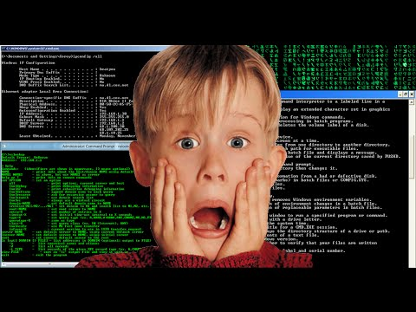
COMMAND LINE ???

Slide 3
CHECK VERSION OF GIT

Slide 4
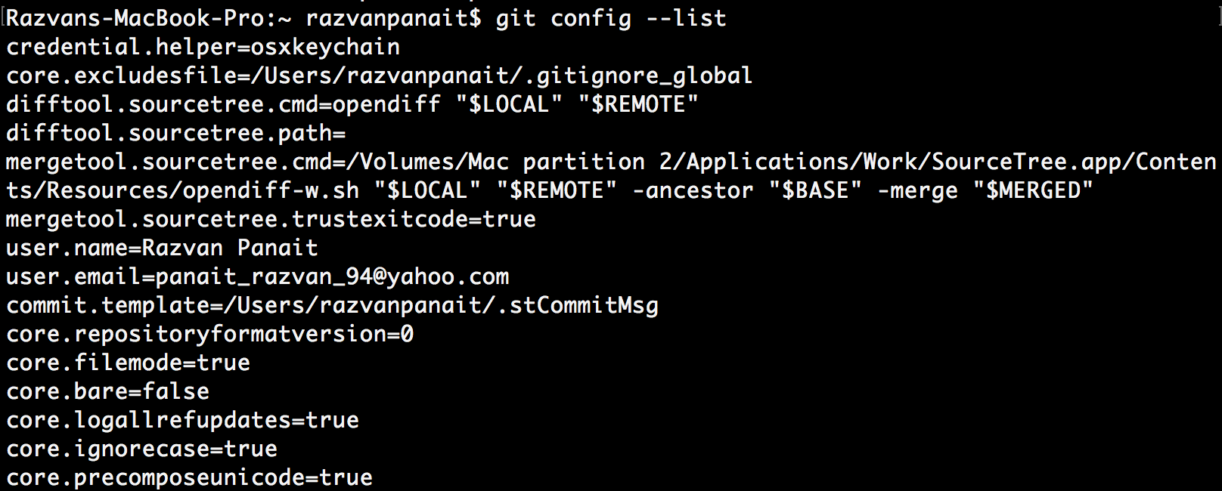
HOW TO SET CONFIG VALUES

Slide 5
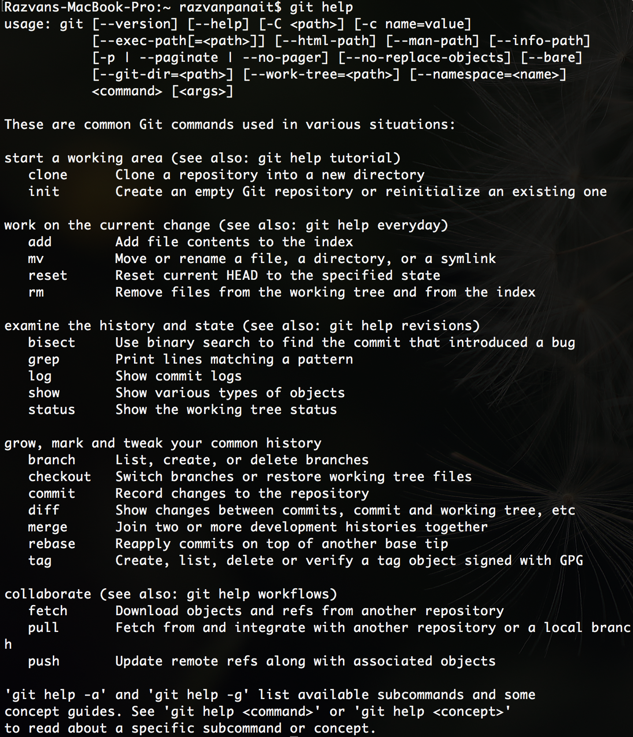
NEED HELP
git help <verb>
git <verb> --help
Example:

Slide 6
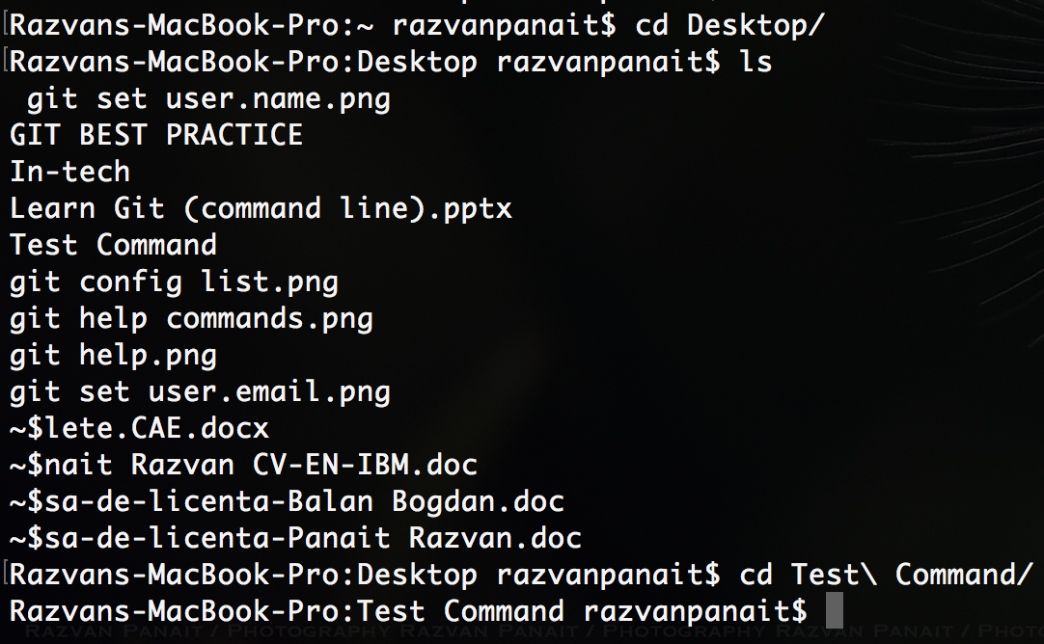
INITIALIZE A REPOSITORY FROM EXISTING CODE
First you need to go to the local repository dir.

Slide 7
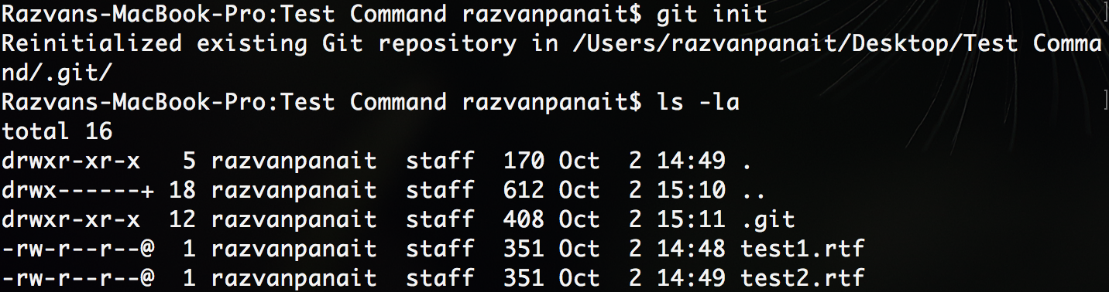
INITIALIZE A REPOSITORY FROM EXISTING CODE
Initialize the repo dir
The .git file contains all the info and data to connect to our repo

Slide 8
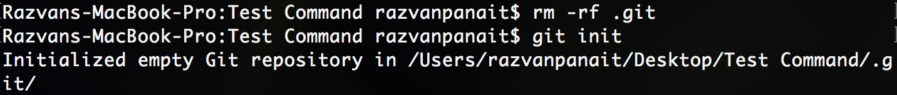
INITIALIZE A REPOSITORY FROM EXISTING CODE
If we want to stop tracking our project with git, we need to remove our .git dir. (remove this .git dir.)
To reinitialize git repository

Slide 9
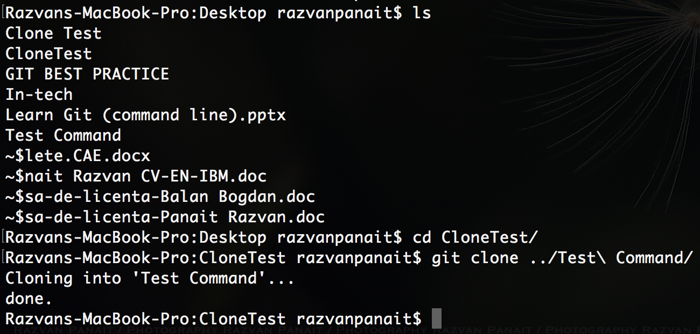
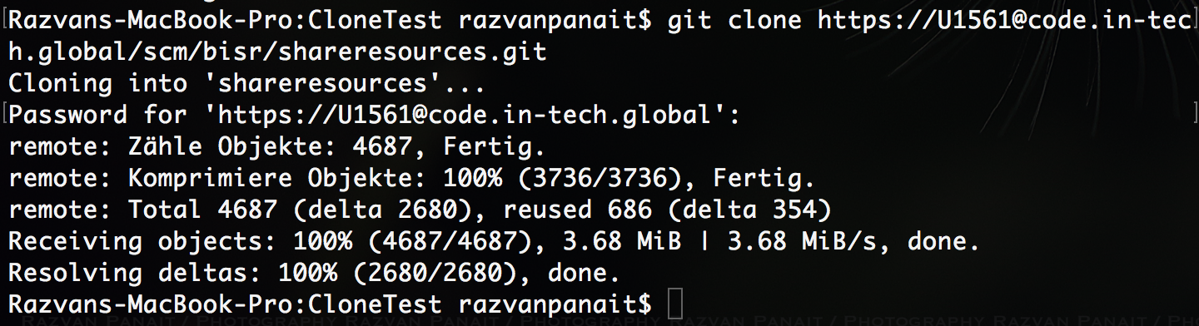
CLONE A REMOTE REPO

Slide 10
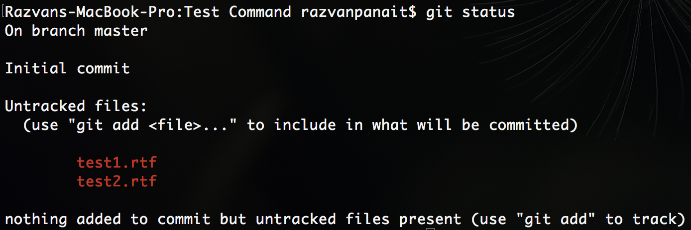
BEFORE COMMIT
Before any commit we want to know the status of git.
As we can see, there are some uncommited changes. Uncommited changes are that files/file that are modified. We need to know everytime what we want commit. For example, lets say that I have some personal preference into a document project, so I don’t want to commit that doc.

Slide 11
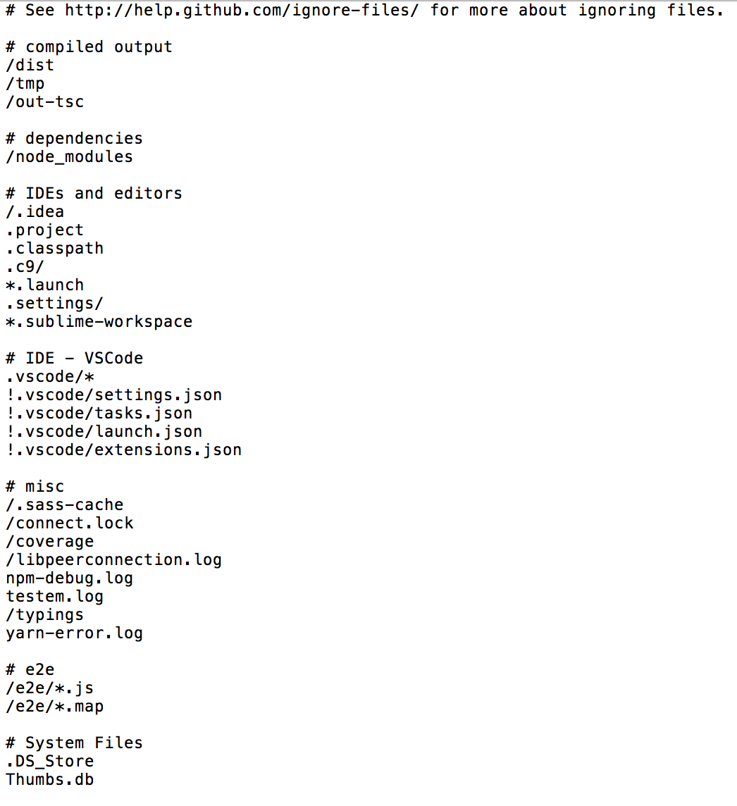
GITIGNORE FILE
Files that we want to be ignored when we make a commit

Slide 12
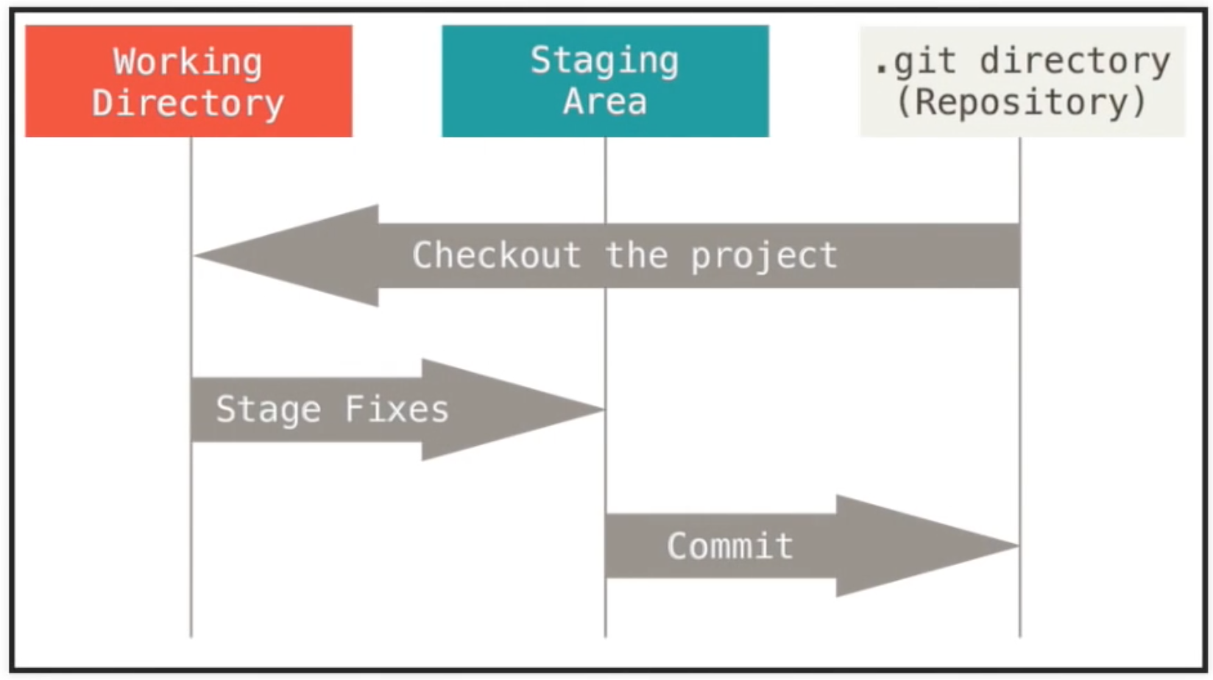
Work flow
Git has three stages:
Working directory
Staging Area
Repository

Slide 13
WORK FLOW
1. Working directory

Slide 14
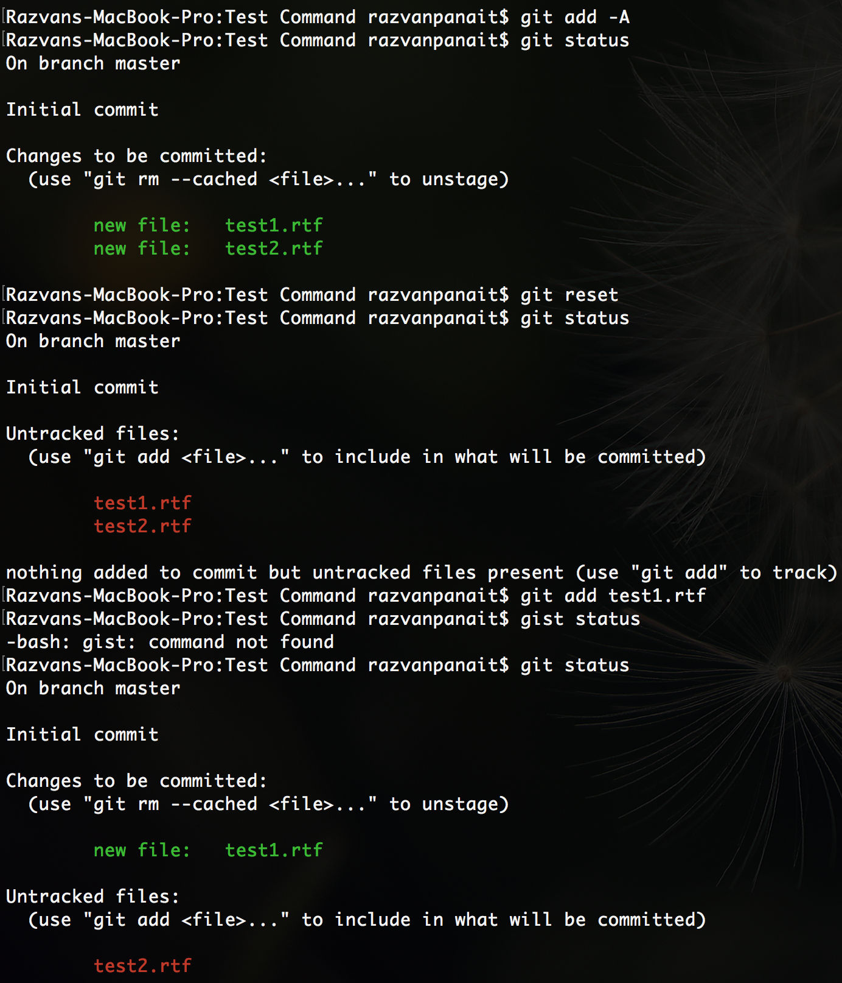
WORK FLOW
2. Staging area

Slide 15
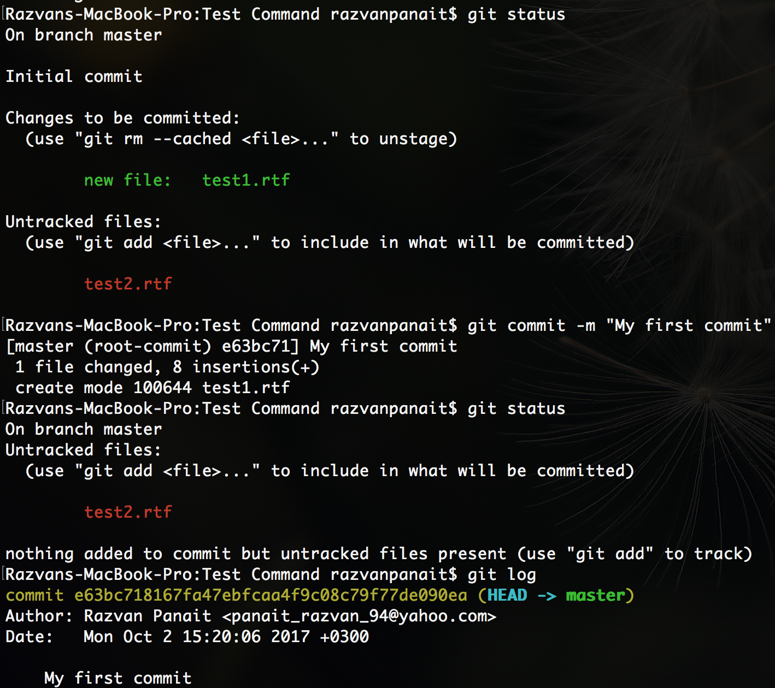
WORK FLOW
3. Repository

Slide 16
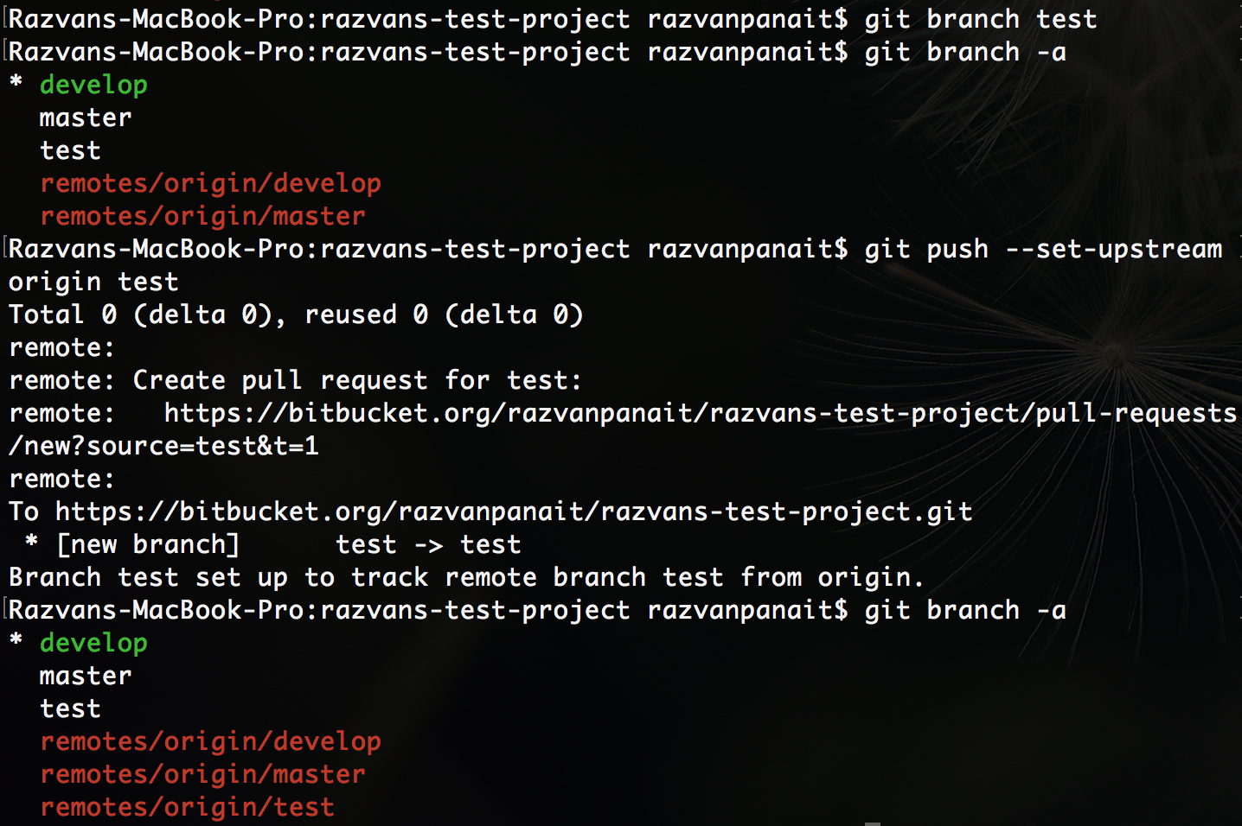
HOW TO MAKE A BRANCH
1. Create branch (git branch <name of branch>)
2. Push the branch on server (git push –set-upstream origin <name of branch>)
3. View all branches (git branch -a)

Slide 17
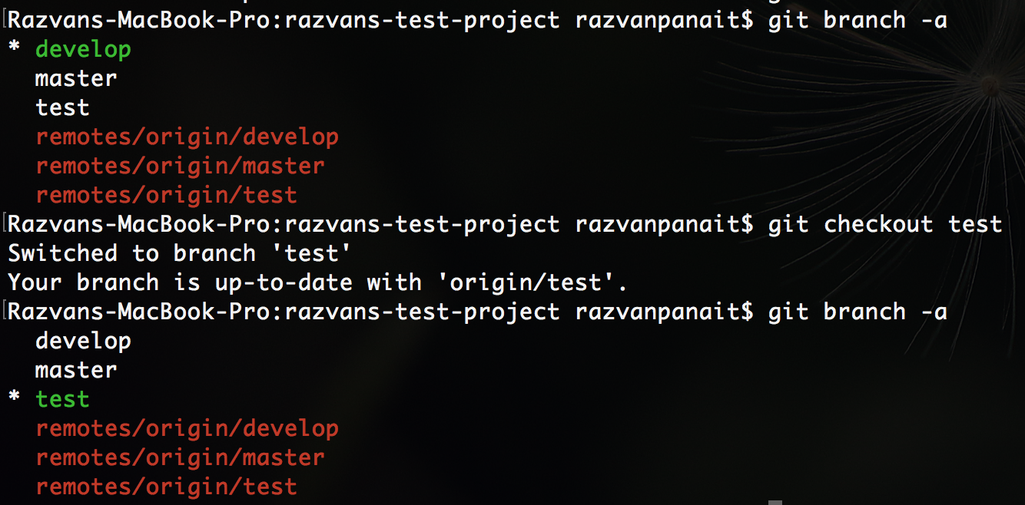
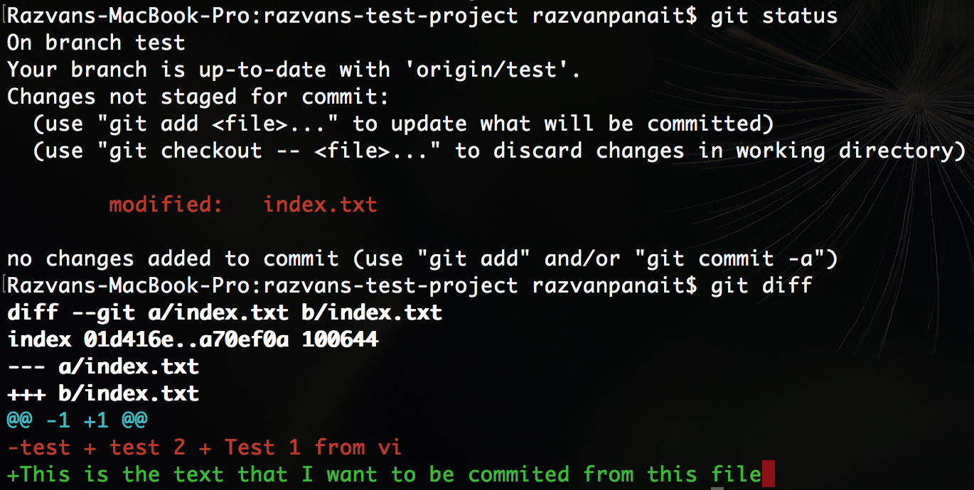
HOW TO MAKE A RIGHT COMMIT AND A PUSH
1. First we need to know on which branch we want to make the commit and the push
2. Make sure you have in stage all the changes that you want to commit

Slide 18
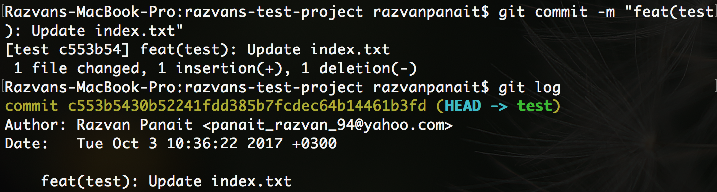
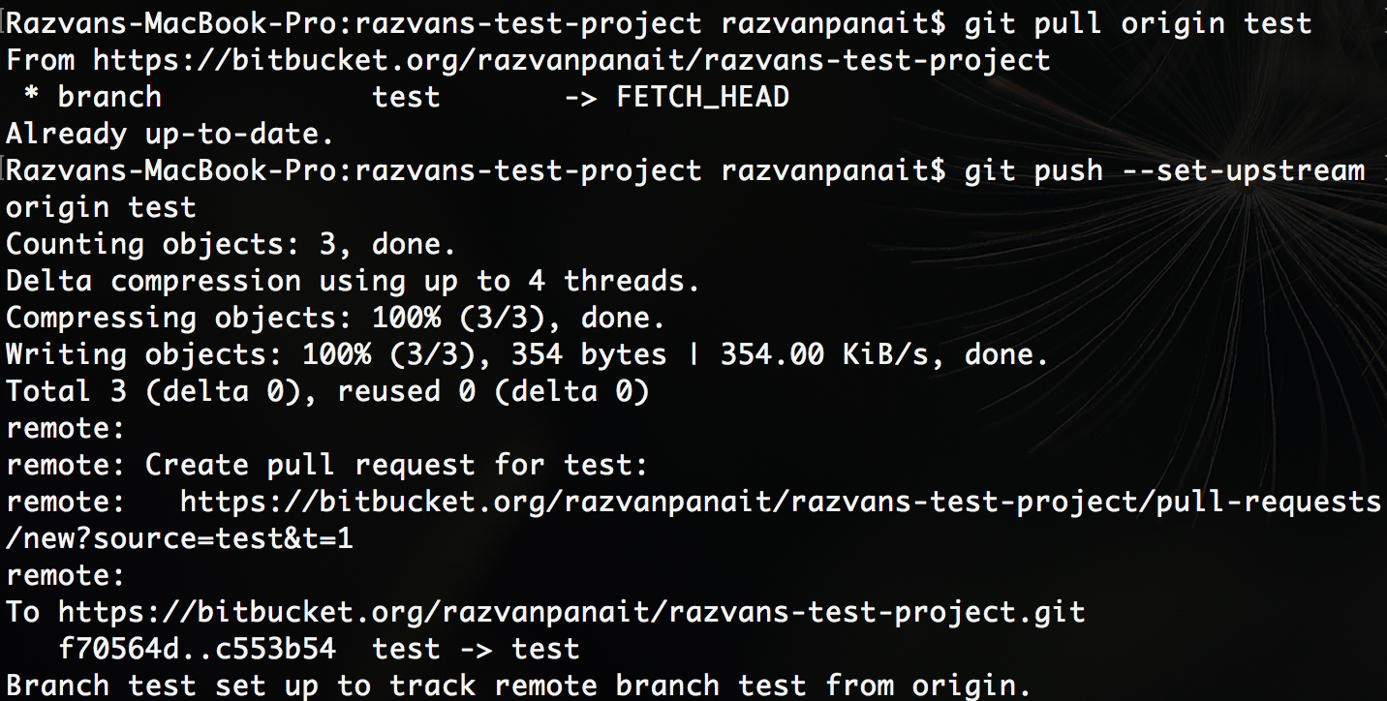
HOW TO MAKE A RIGHT COMMIT AND A PUSH
3. Lets make the commit with a specific message
4. After you make the commit make sure that on the branch were you’ve done the commit is up to date. For that first you need to make a pull then push.

Slide 19
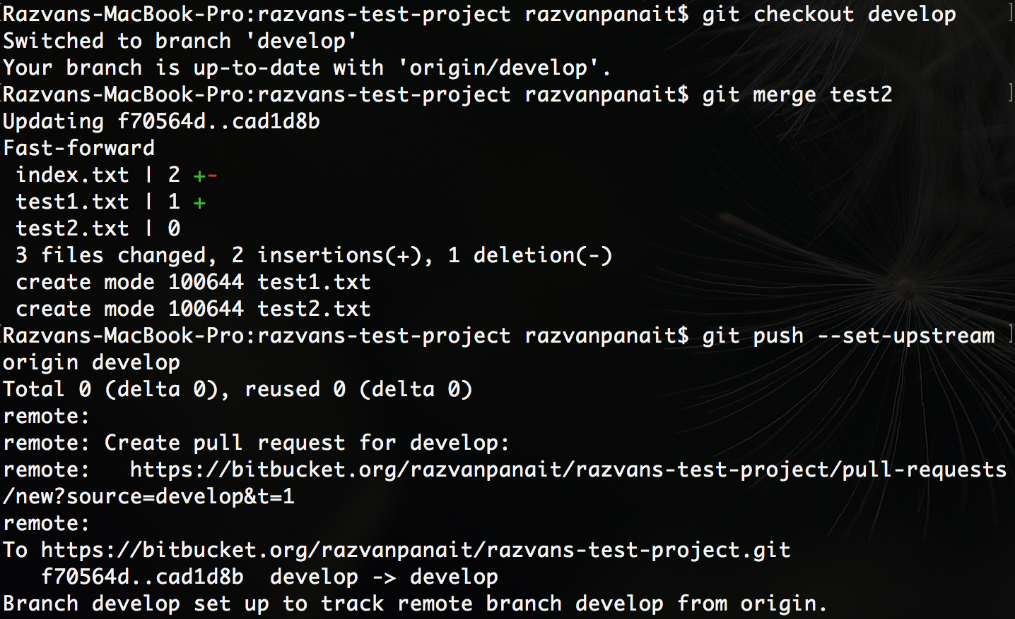
HOW TO MAKE A RIGHT MERGE
1. Checkout the branch where you want to have all the changes from the other branch
2. Merge the branch that you want to be merged
3. Push the merge between the two branches

Slide 20
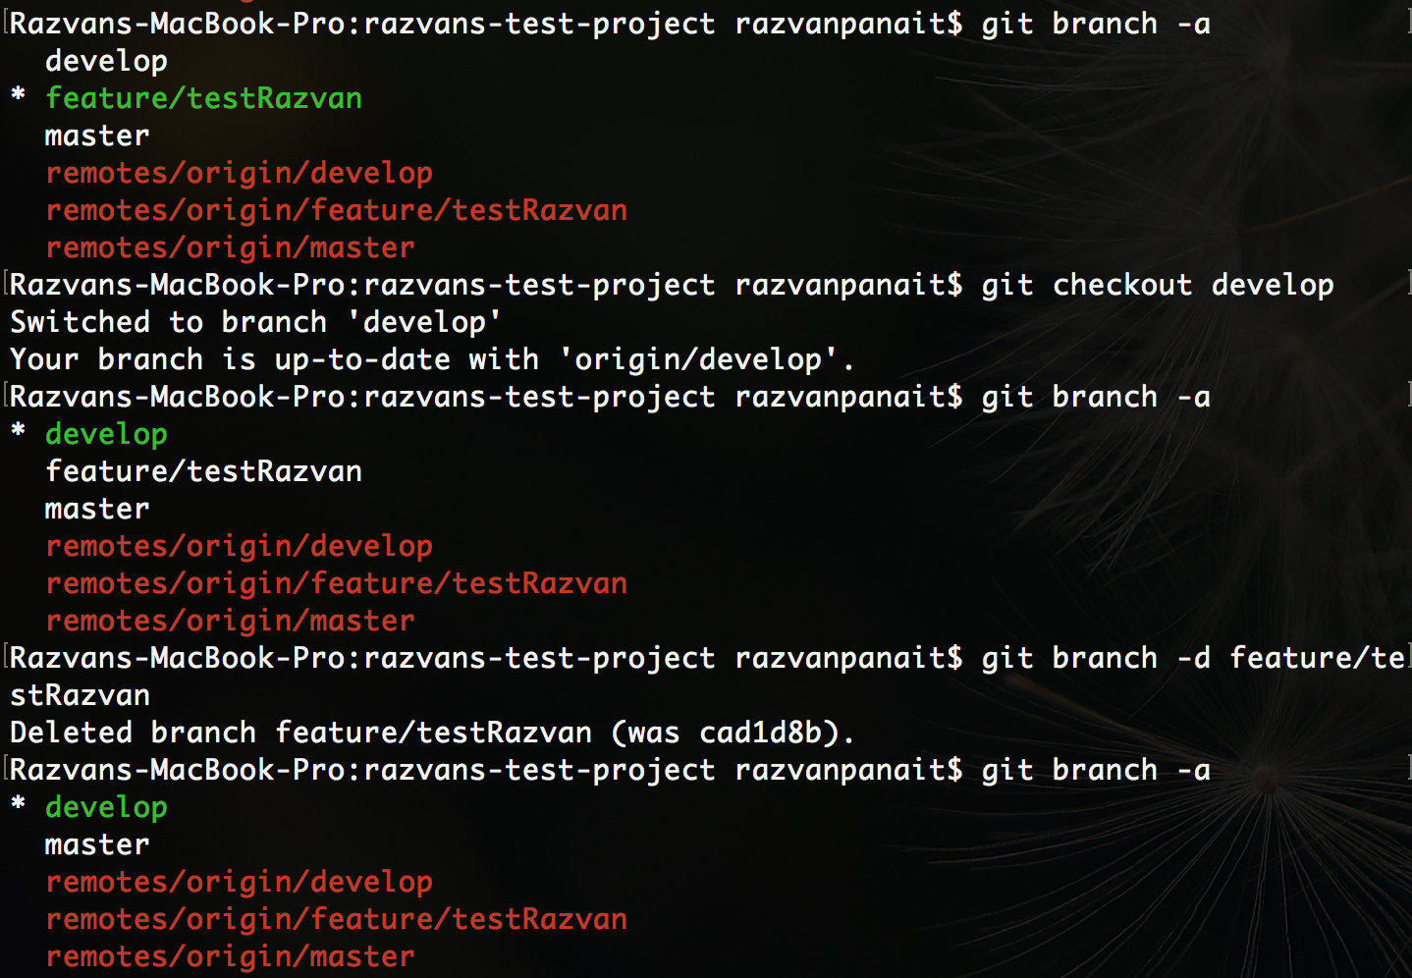
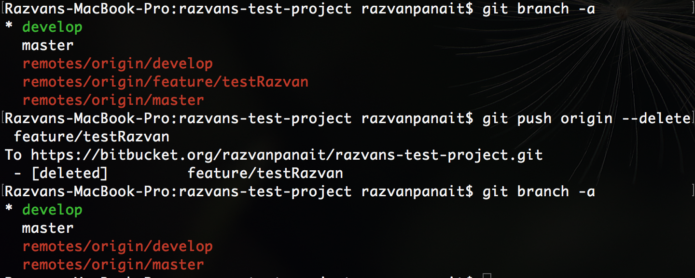
DELETE BRANCH
1. Delete branch from local repo
2. Delete branch from origin

Slide 21
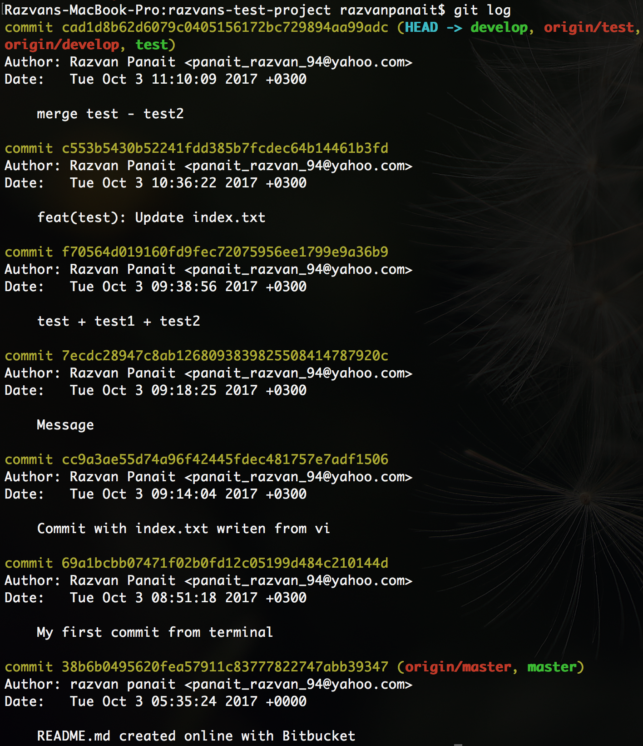
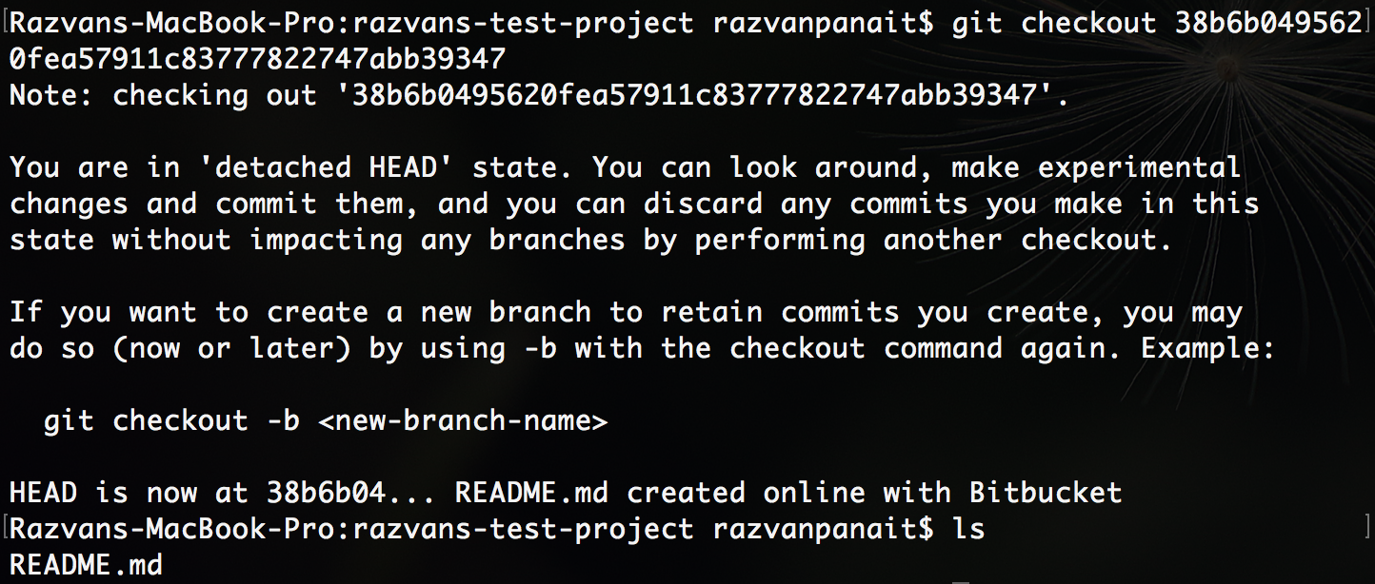
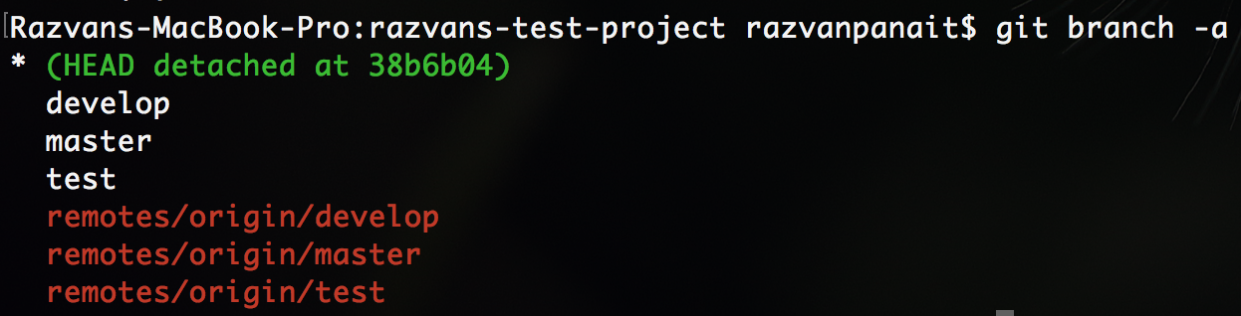
HOW TO REVERT TO A SPECIFIC COMMIT
1. Type “git log” commang
2. Copy the commit number, then type “git checkout <number of the commit>”
3. Now you are in detached mode

Slide 22
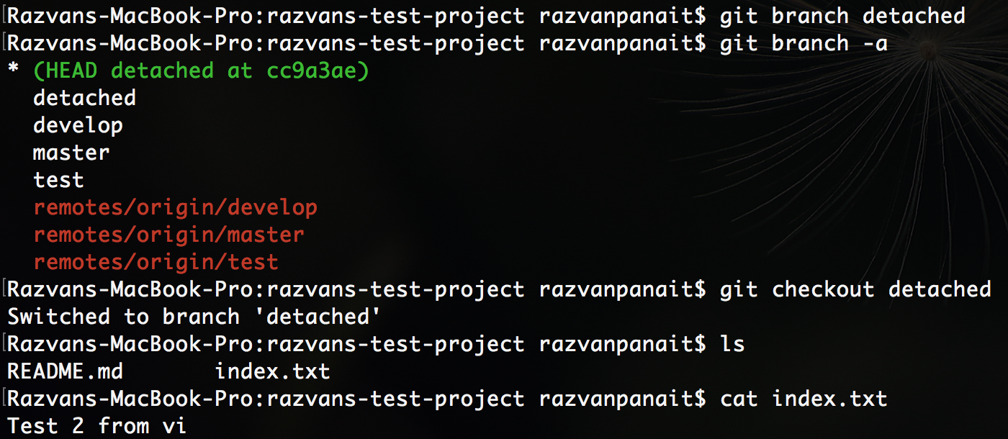
HOW TO REVERT TO A SPECIFIC COMMIT
4. If you want to apply this commit to a specific branch, you only need to create a branch from that commit.

Slide 23
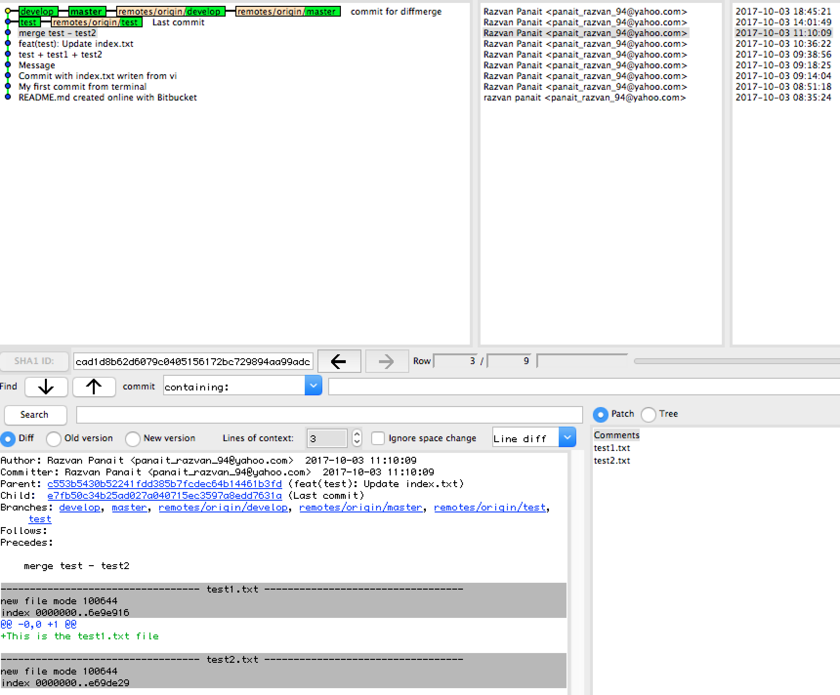
HOW TO REVERT TO A SPECIFIC COMMIT
Use gitk to see all the tree and it can be used to go back to a specific commit even if that branch has been deleted.
Command : gitk -all

Slide 24

Thanks!

